Slide 1
Probability Of Detection System
Software Engineering Group L
Naman Singhal - 160001038

Slide 2
Probability Of Detection
The theoretical model used in electro optical systems is similar to the models used in radar and laser systems and the detection on sinusoidal signal in gaussian noise.
This is popular because an analytical solution is obtained where a the probability of detection can be related to signal to noise ratio.
Considering a sinusoidal signal argument by gaussian noise in the detection filter. The expression results are...

Slide 3
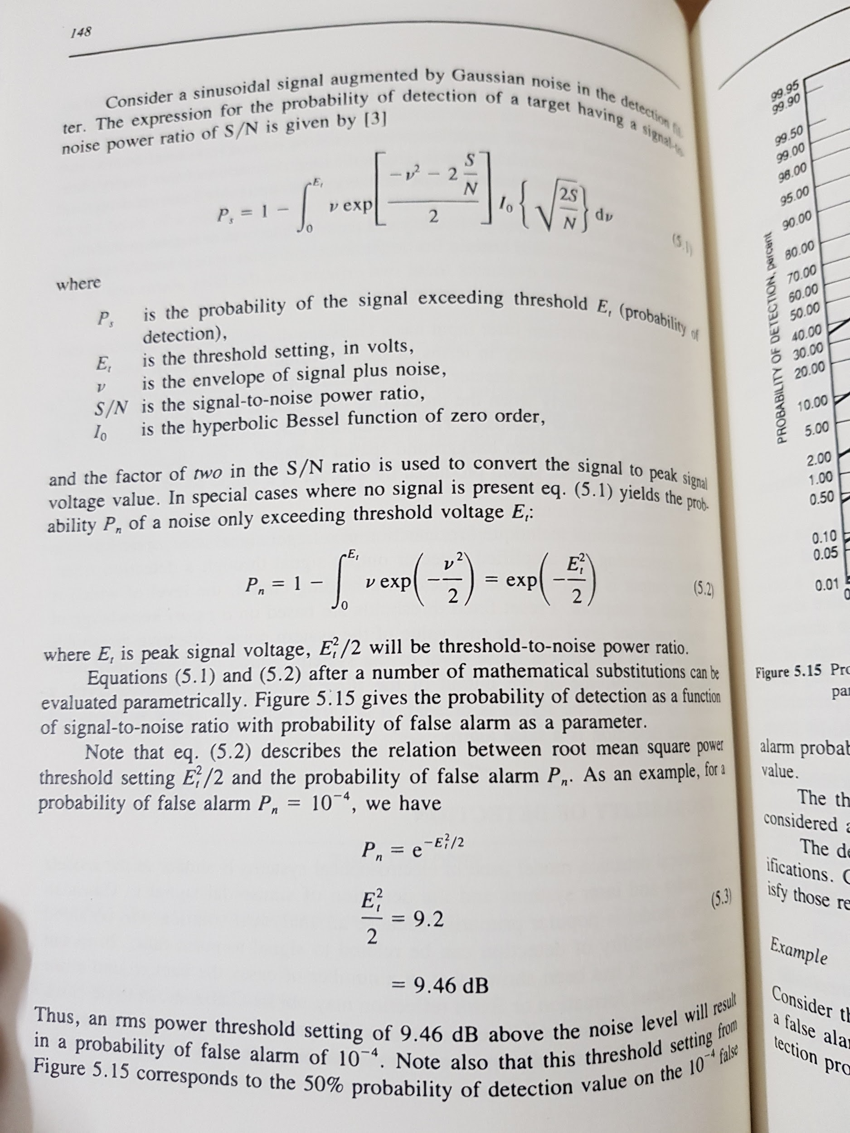
P_{s} is the probability of the signal exceeding threshold E_{t} (Probability of Detection)
E_{t} is the threshold setting, in volts
v is the envelope of signal plus noise
S/N is the signal to noise power ratio
I₀ is the hyperbolic Bessel function of zero order

Slide 4
P_{n} is the probability of the noise exceeding threshold E_{t} (Probability of False Alarm)
E_{t} is the threshold setting, in volts
v is the envelope of signal plus noise

